Slide 1
EE 422C Multithreading & Parallel Programming

Slide 2
Concurrency
In real life, things happen concurrently.
In hardware design, we have all parts of a circuit working at the same time.
In software, things happen one after the other, in sequence.

Slide 3
Operating System Terminology
Kernel - The central component of the computer operating systems. The kernel's responsibilities include among other things context switching.
Context Switch - A context switch is the process of storing and restoring the state (context) of a CPU such that multiple processes can share a single CPU resource
Preemption - preemption is the act of temporarily interrupting a task being carried out by a computer system, without requiring its cooperation, and with the intention of resuming the task at a later time.

Slide 4
Multithreading
View a process as a collection of one or more threads that can run simultaneously
All threads within the same process share the same data and resources and a part of the process’s execution context
Easier to create or destroy a thread and switch between threads (of the same process) than to create/switch processes
“Context switch” for a process is a bigger operation than switching threads, because threads run in the same virtual memory space, etc, shares open files, etc….

Slide 5
Advantages of Multithreading
Reactive systems – constantly monitoring
More responsive to user input – GUI application can interrupt a time-consuming task
Server can handle multiple clients simultaneously
Can take advantage of parallel processing

Slide 6
Threads vs. Processes
Threads are used for small tasks, whereas processes are used for more 'heavyweight' tasks – basically the execution of applications.
Another difference between a thread and a process is that threads within the same process share the same address space, whereas different processes do not.

Slide 7
Examples of Multithreading
Typing in a word processor while it is saving or spellchecking.
Chrome
Each tab is a thread
Massively parallel server monitoring infrastructure, for example you are required to monitor 30K servers/routers every 5 seconds
Long running applications like batch jobs, do well when multithreaded.
Any GUI toolkit, like Swing, Javafx, SWT/JFace all uses threads to keep track of events generating from various widgets in the GUI
HTTP/JEE servers/frameworks like vert.x, wildfly, tomcat, jetty uses multithreads along with NIO to achieve high throughput.
JUnit uses threads to run test cases in parallel.
Computer games, exemplary multi-threaded processing.

Slide 8
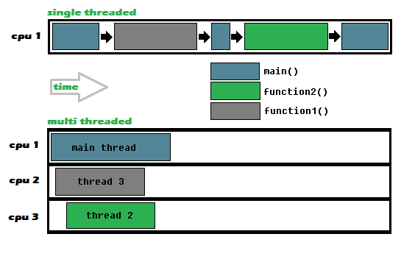
Single vs. multiple CPU

Slide 9
Thread Scheduling
An operating system’s thread scheduler determines which thread runs next.
Most operating systems use timeslicing for threads of equal priority.
Preemptive scheduling: when a thread of higher priority enters the running state, it preempts the current thread.
Starvation: Higher-priority threads can postpone (possible forever) the execution of lower-priority threads.

Slide 10
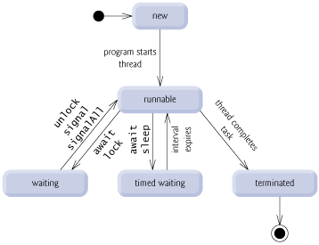
Thread States
http://www.deitel.com/articles/java_tutorials/20051126/JavaMultithreading_Tutorial_Part2.html

Slide 11
Thread termination
A thread becomes Not Runnable when one of these events occurs:
Its sleep method is invoked.
The thread calls the wait method to wait for a specific condition to be satisifed.
The thread is blocking on I/O.

Slide 12
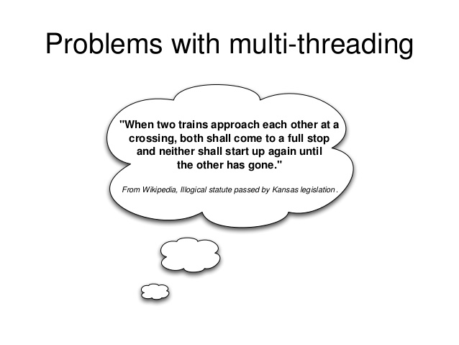

Slide 13
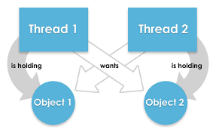
Deadlock

Slide 14
Starvation
If a thread is not granted CPU time because other threads grab it all, it is called "starvation".
The thread is "starved to death" because other threads are allowed the CPU time instead of it. The solution to starvation is called "fairness" - that all threads are fairly granted a chance to execute.

Slide 15
Race Condition
What, then, caused the error in the example? Here is a possible scenario:
The effect of this scenario is that Task 1 did nothing, because in Step 4 Task 2 overrides Task 1's result. Obviously, the problem is that Task 1 and Task 2 are accessing a common resource in a way that causes conflict. This is a common problem known as a race condition in multithreaded programs. A class is said to be thread-safe if an object of the class does not cause a race condition in the presence of multiple threads. As demonstrated in the preceding example, the Account class is not thread-safe.

Slide 16
Java Tasks and Threads
In Java, each task is an instance of the Runnable interface, also called a runnable object.
A thread is essentially an object that facilitates the execution of a task.

Slide 17
Tasks and Threads
A Task object implements the Runnable interface.
A run method in the Task object describes the task that has to run in that thread.
A Thread object is created with the task object as parameter.
thread_object.start() tells the JVM that the thread is ready to run.

Slide 18
Using a thread -- Runnable
// custom task class
public Class TaskClass implements Runnable { …
public TaskClass(…) {…}
// implement run method
public void run() {
// tell system how to run custom thread
}
…
}
// Client class
public class Client { …
public void someMetd() {
// create instance of TaskClass
TaskClass task = new TaskClass(…);
// create a thread
Thread thr = new Thread(task);
thr.start();
}
}

Slide 19
The Static sleep(milliseconds) Method
The sleep(long mills) method puts the thread to sleep for the specified time in milliseconds. For example, suppose you modify the code in Lines 53-57 in TaskThreadDemo.java as follows:
public void run() {
for (int i = 1; i <= lastNum; i++) {
System.out.print(" " + i);
try {
if (i >= 50) Thread.sleep(1);
}
catch (InterruptedException ex) {
}
}
}
Every time a number (>= 50) is printed, the print100 thread is put to sleep for 1 millisecond.

Slide 20
The join() Method
You can use the join() method to force one thread to wait for another thread to finish. For example, suppose you modify the code in Lines 53-57 in TaskThreadDemo.java as follows:
The numbers after 50 are printed after thread printA is finished.

Slide 21
Thread priorities
Java assigns every thread a priority.
Increase or decrease the priority of any thread by using the setPriority method.
Priorities are numbers ranging from 1 to 10. The Thread class has the int constants MIN_PRIORITY, NORM_PRIORITY, and MAX_PRIORITY, representing 1, 5, and 10, respectively.
The priority of the main thread is Thread.NORM_PRIORITY.
The JVM always picks the currently runnable thread with the highest priority.
If all runnable threads have equal priorities, each is assigned an equal portion of the CPU time in a circular queue. This is called round-robin scheduling. F

Slide 22
isAlive(), interrupt(), and isInterrupted()
The isAlive() method is used to find out the state of a thread. It returns true if a thread is in the Ready, Blocked, or Running state; it returns false if a thread is new and has not started or if it is finished.
The interrupt() method interrupts a thread in the following way: If a thread is currently in the Ready or Running state, its interrupted flag is set; if a thread is currently blocked, it is awakened and enters the Ready state, and an java.io.InterruptedException is thrown.
The isInterrupt() method tests whether the thread is interrupted.

Slide 23
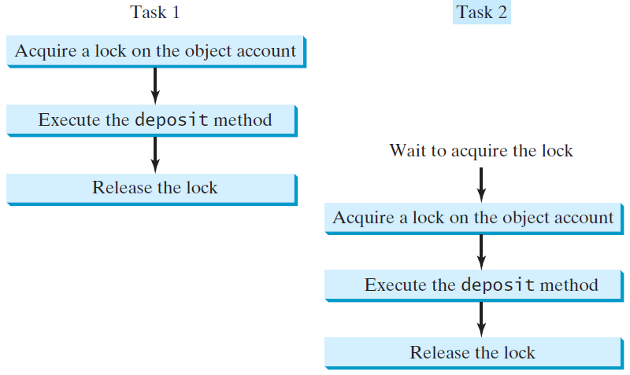
Synchronizing Tasks

Slide 24
Intrinsic Locks and Synchronization
Synchronization is built around an internal entity known as the intrinsic lock or monitor.
Every object has an intrinsic lock associated with it.
A thread that needs exclusive and consistent access to an object's fields has to acquire the object's intrinsic lock before accessing them, and then release the intrinsic lock when it's done with them.
A thread is said to own the intrinsic lock between the time it has acquired the lock and released the lock.
As long as a thread owns an intrinsic lock, no other thread can acquire the same lock.
The other thread will block when it attempts to acquire the lock.
When a thread releases an intrinsic lock, a happens-before relationship is established between that action and any subsequent acquisition of the same lock.

Slide 25
Synchronization
To make a method synchronized, simply add the synchronized keyword to its declaration:
public class SynchronizedCounter {
private int c = 0;
public synchronized void increment() {
c++;
}
public synchronized void decrement() {
c--;
}
public synchronized int value() {
return c;
}
}
Notes:
https://docs.oracle.com/javase/tutorial/essential/concurrency/syncmeth.html

Slide 26
Synchronization
If count is an instance of SynchronizedCounter, then making these methods synchronized has two effects:
It is not possible for two invocations of synchronized methods on the same object to interleave. Other threads that want the same method will wait.
When a synchronized method exits, it automatically establishes a happens-before relationship with any subsequent invocation of a synchronized method for the same object. This guarantees that changes to the state of the object are visible to all threads.
Constructors cannot be synchronized.

Slide 27
Synchronized Statements
Synchronized statements must specify the object that provides the intrinsic lock:
public void addName(String name) {
synchronized(this) {
lastName = name; nameCount++;
}
nameList.add(name);
}
Avoid synchronizing invocations of other objects' methods.

Slide 28
Synchronized Statements
synchronized(this) {
}
The parameter to synchronized is a reference to an object.
The object is locked until the statements finish executing.
No changes can be made to the object.
The lock is released upon finishing the statements.
No other thread can interleave with the statements inside the synchronized block.

Slide 29
Synchronized Collections
Invoking synchronizedCollection(Collection c) returns a new Collection object, in which all the methods that access and update the original collection c are synchronized.
These methods are implemented using the synchronized keyword.
For example, the add method is implemented like this:
public boolean add(E o {
synchronized (this) {
return c.add(o);
}
}

Slide 30
Reentrant Synchronization
Recall that a thread cannot acquire a lock owned by another thread.
But a thread can acquire a lock that it already owns. Allowing a thread to acquire the same lock more than once enables reentrant synchronization.

